Slide 1


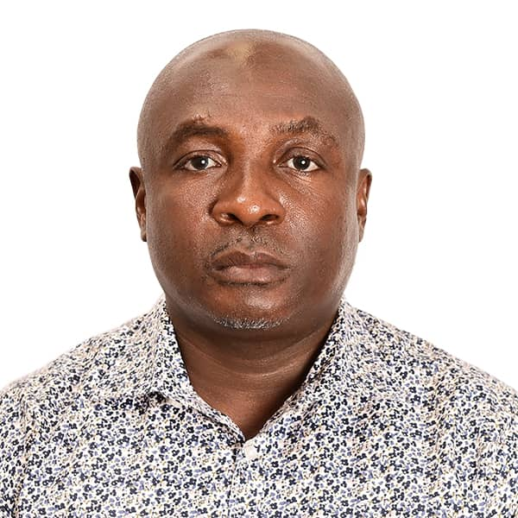
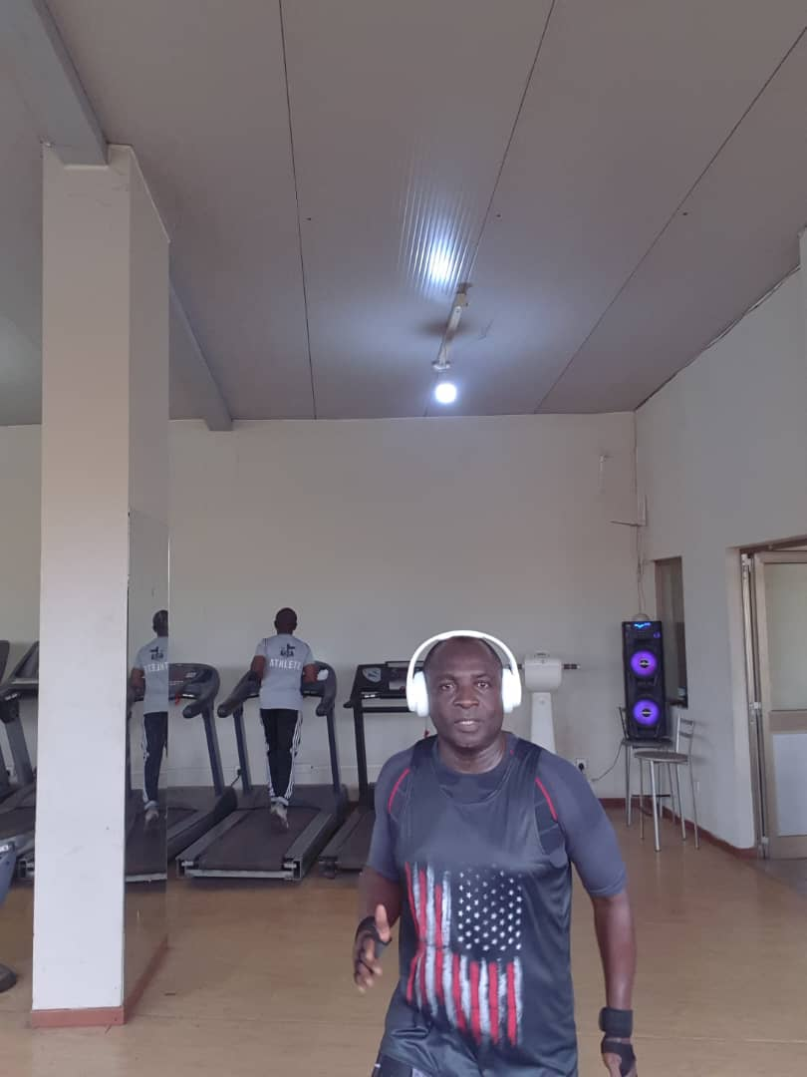
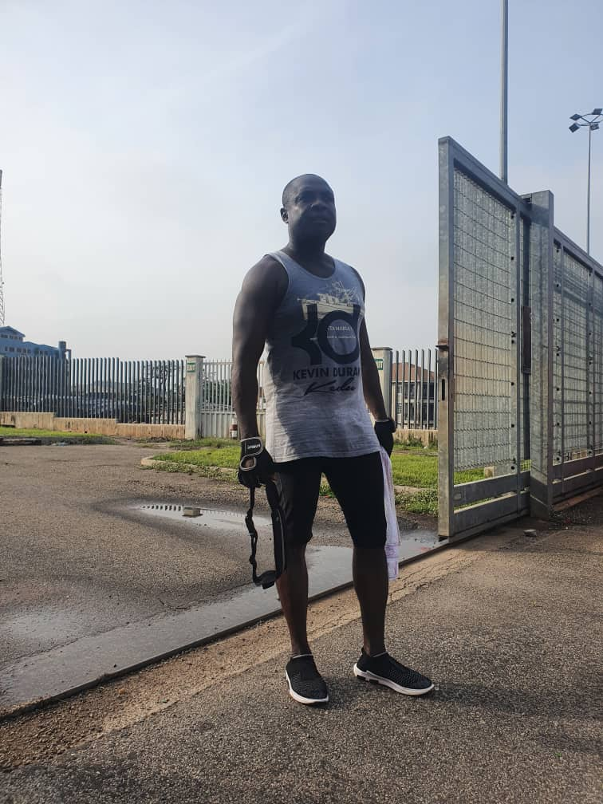
Getting to Know Me
Work
Personal
My role
Deputy Finance Manager
Significant others / family members / furry friends in my life
Betty Okyere, Nana Odoi Asumang and Kwabena Odoi Boadu
Tenure in ofi/Olam
22 years
How I enjoy spending my free time
Brisk Walk, Aerobics Exercise and watching football
Previous companies I have worked at
Shangri-la Hotel Limited
My favorite / comfort food
Fufu with light soup
Why I joined ofi/Olam and what keeps me here?
Ofi reputation as industry leader in the Beans Business
Skills diversification and career progression
My favorite song
Redemption Song
Bismark Odoi
Bismark
Very Sportive in nature
Like hanging out with friends
This is me outside work, doing stuff I enjoy in my life …

